Slide 1
Malignant Commentes Classifier - using NLP
By
VANISREE P G

Slide 2
INTRODUCTION
Online platforms when used by normal people can only be comfortably used by them only when they feel that they can express themselves freely and without any reluctance.
If they come across any kind of a malignant or toxic type of a reply which can also be a threat or an insult or any kind of harassment which makes them uncomfortable, they might defer to use the social media platform in future.
Thus, it becomes extremely essential for any organization or community to have an automated system which can efficiently identify and keep a track of all such comments and thus take any respective action for it, such as reporting or blocking the same to prevent any such kind of issues in the future.
This is a huge concern as in this world, there are 7.7 billion people, and, out of these 7.7 billion, more than 3.5 billion people use some or the other form of online social media.
Which means that every one-in-three people uses social media platform.

Slide 3
This problem thus can be eliminated as it falls under the category of Natural Language Processing.
In this, we try to recognize the intention of the speaker by building a model that’s capable of detecting different types of toxicity like threats, obscenity, insults, and identity-based hate.
Moreover, it is crucial to handle any such kind of nuisance, to make a more user-friendly experience, only after which people can actually enjoy in participating in discussions with regard to online conversation.

Slide 4
PROBLEM STATEMENT
The proliferation of social media enables people to express their opinions widely online. However, at the same time, this has resulted in the emergence of conflict and hate, making online environments uninviting for users. Although researchers have found that hate is a problem across multiple platforms, there is a lack of models for online hate detection.
Our goal is to build a prototype of online hate and abuse comment classifier which can used to classify hate and offensive comments so that it can be controlled and restricted from spreading hatred and cyber bullying.

Slide 5
Data Sources
The data set contains the training set, which has approximately 1,59,000 samples and the test set which contains nearly 1,53,000 samples. All the data samples contain 8 fields which includes ‘Id’, ‘Comments’, ‘Malignant’, ‘Highly malignant’, ‘Rude’, ‘Threat’, ‘Abuse’ and ‘Loathe’. The label can be either 0 or 1, where 0 denotes a NO while 1 denotes a YES. There are various comments which have multiple labels. The first attribute is a unique ID associated with each comment.
The Train data set includes:-
Malignant: It is the Label column, which includes values 0 and 1, denoting if the comment is malignant or not. –
Highly Malignant: It denotes comments that are highly malignant and hurtful. -
Rude: It denotes comments that are very rude and offensive.-
Threat: It contains indication of the comments that are giving any threat to someone. -
Abuse: It is for comments that are abusive in nature. -
Loathe: It describes the comments which are hateful and loathing in nature.
Testdata set
ID: It includes unique Ids associated with each comment text given.
Comment text: This column contains the comments extracted from various social media platforms

Slide 6
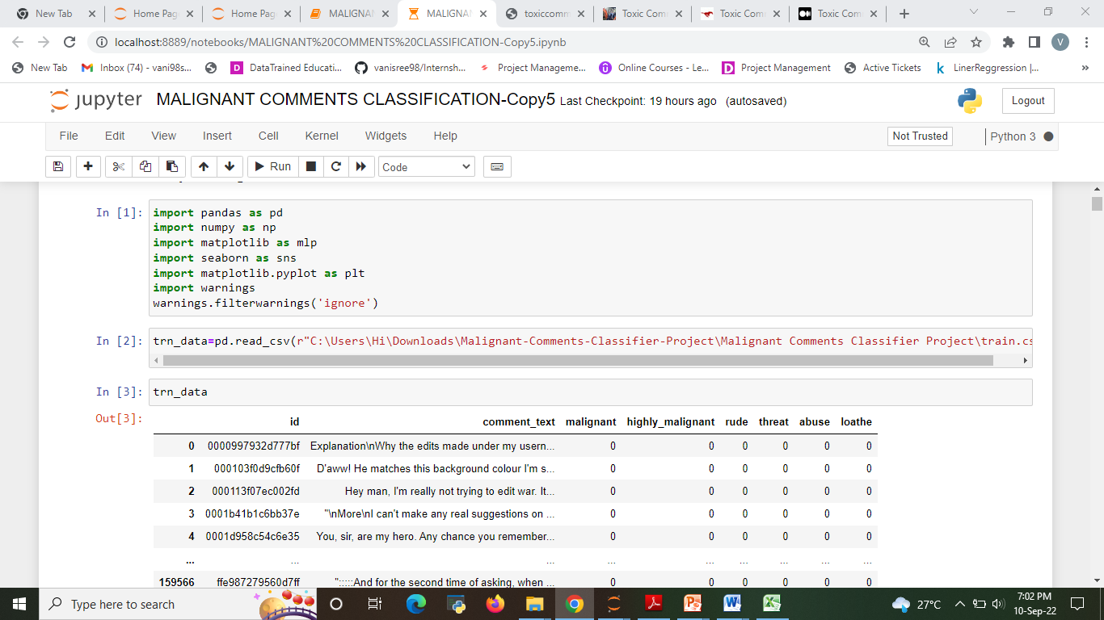
DATA UPLOADING

Slide 7
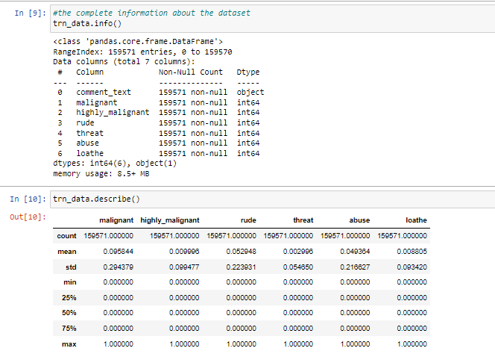

Slide 8
Data Pre-processing Done
Convert the text to lowercase
Remove the punctuations, digits and special characters
Tokenize the text, filter out the adjectives used in the review and create a new column in data frame
Remove the stop words
Stemming and Lemmatising
Applying Text Vectorization to convert text into numeric

Slide 9
MODELS USED
Regression Model with following algorithms
Linear Regression
Decision Tree Regression
SVR
Evaluation metrics
Accuracy Score
classification Report
Confusion matrix

Slide 10
Testing of Identified Approaches (Algorithms)
Listing down all the algorithms used for the training and testing.
LR=LinearRegression()
DT=DecisionTreeRegressor()
R=Ridge()

Slide 11
Word Cloud for getting word sense
A word cloud is a simple yet powerful visual representation object for text processing, which shows the most frequent word with bigger and bolder letters, and with different colors. The smaller the the size of the word the lesser it’s important
Significant textual data points can be highlighted using a word cloud.
The enlarged texts are the greatest number of words used there and small texts are the smaller number of words used

Slide 12
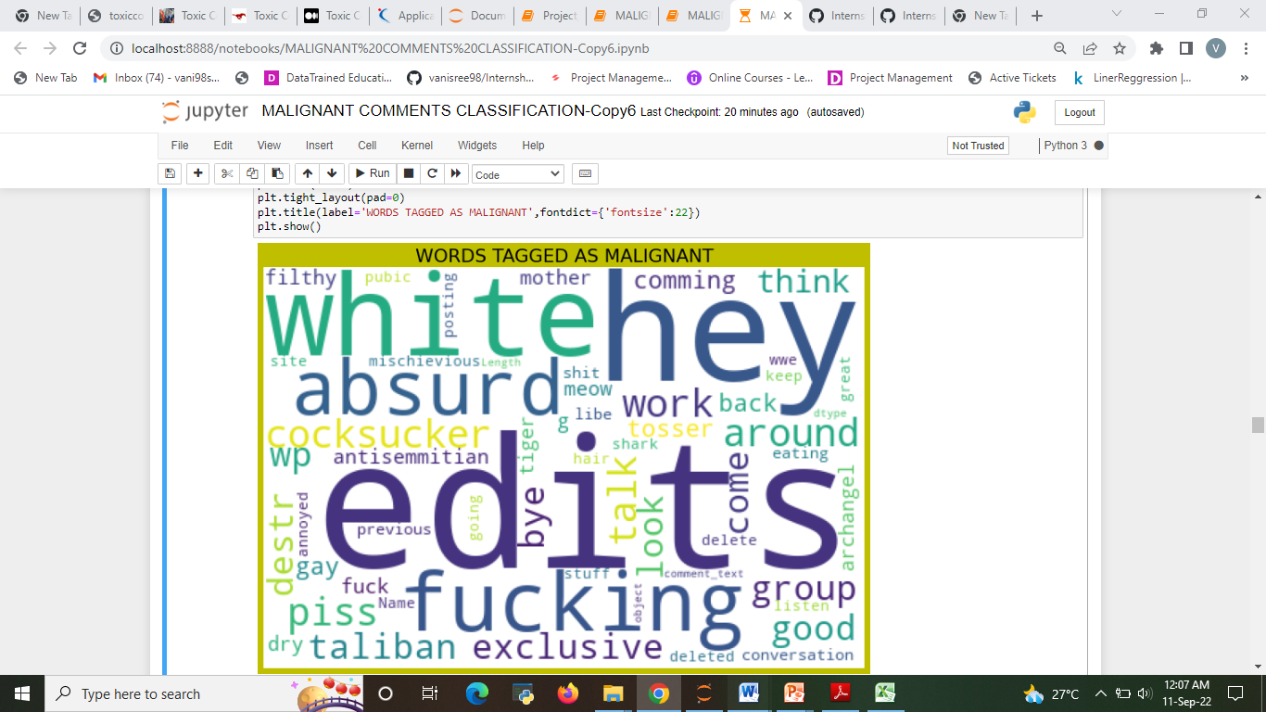
Word Cloud for WORDS TAGGED AS MALIGNANT

Slide 13
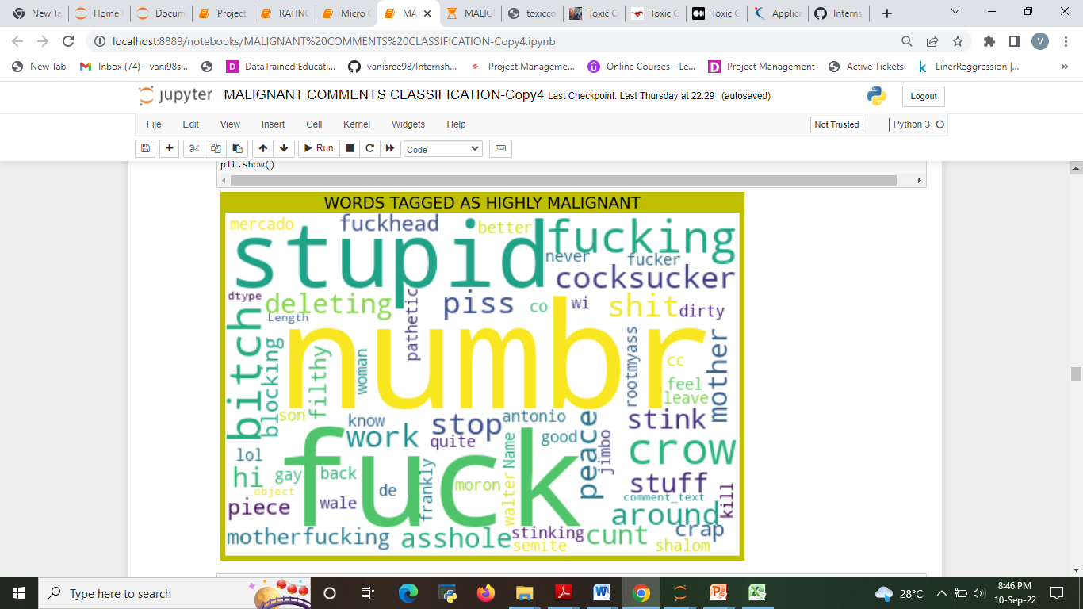
Word Cloud for WORDS TAGGED AS HIGHLY MALIGNANT
Getting sense of loud words in Rating 5

Slide 14
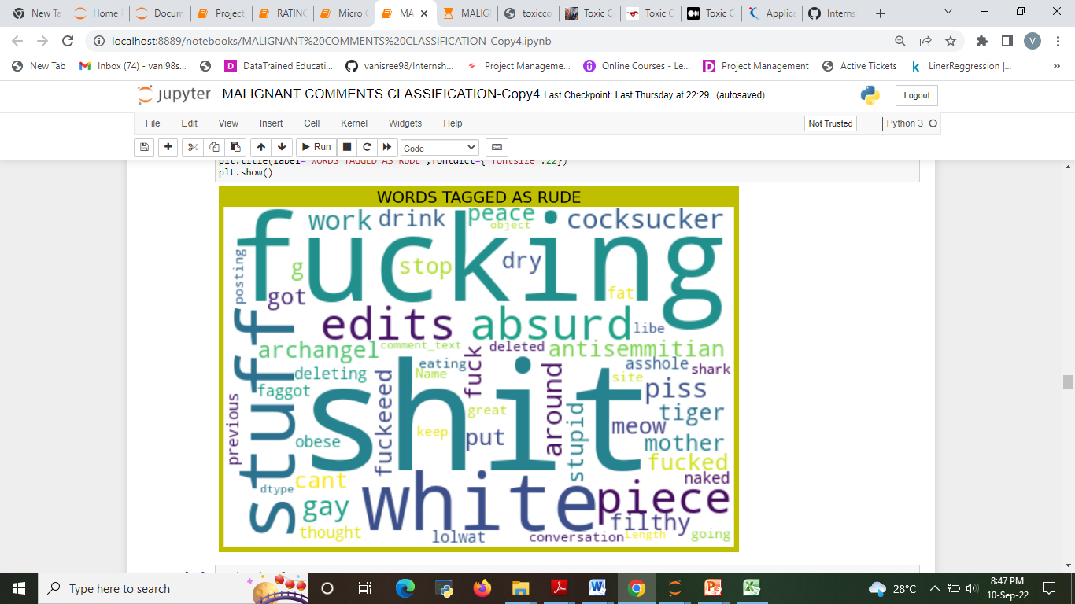
Word Cloud for WORDS TAGGED AS RUDE

Slide 15
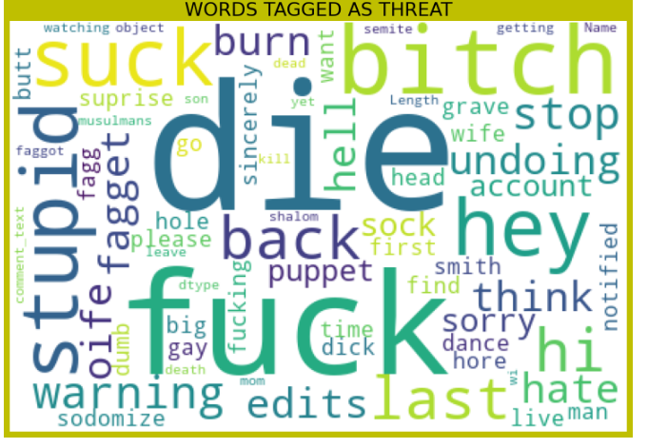
Word Cloud for WORDS TAGGED AS THREAT

Slide 16
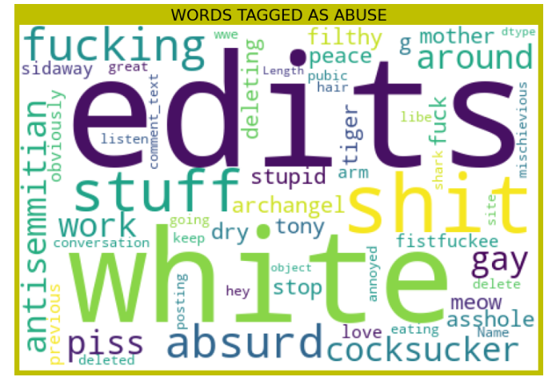
Word Cloud for WORDS TAGGED AS ABUSE

Slide 17
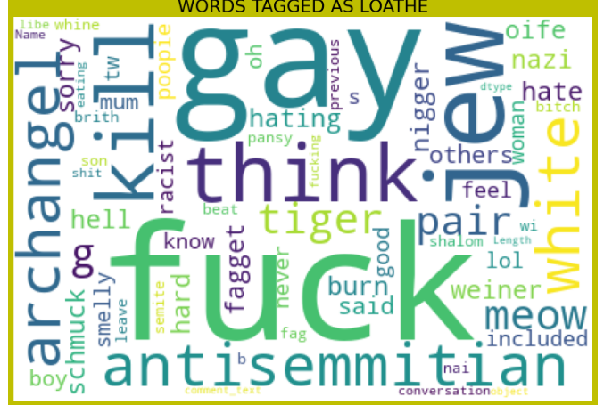
Word Cloud for WORDS TAGGED AS LOATHE

Slide 18
Machine Learning MODELS USED
Regression Model with following algorithms
Linear Regression
Decision Tree Regression
SVR

Slide 19
Machine Learning Evaluation Matrix
Accuracy Score
Confusion matrix of Model

Slide 20
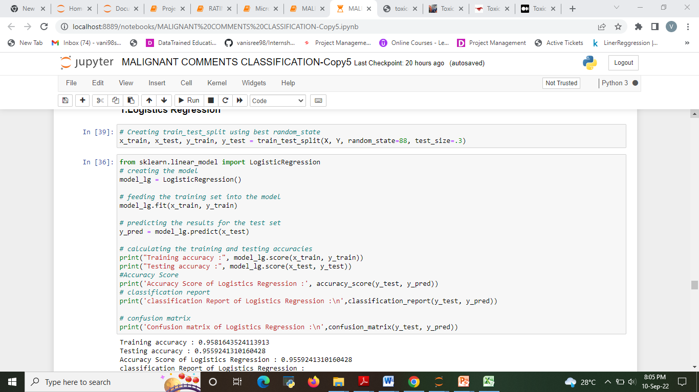
Run and Evaluate selected models 1.Linear Regression
Describe all the algorithms used along with the snapshot of their code and what were the results observed over different evaluation metrics.

Slide 21
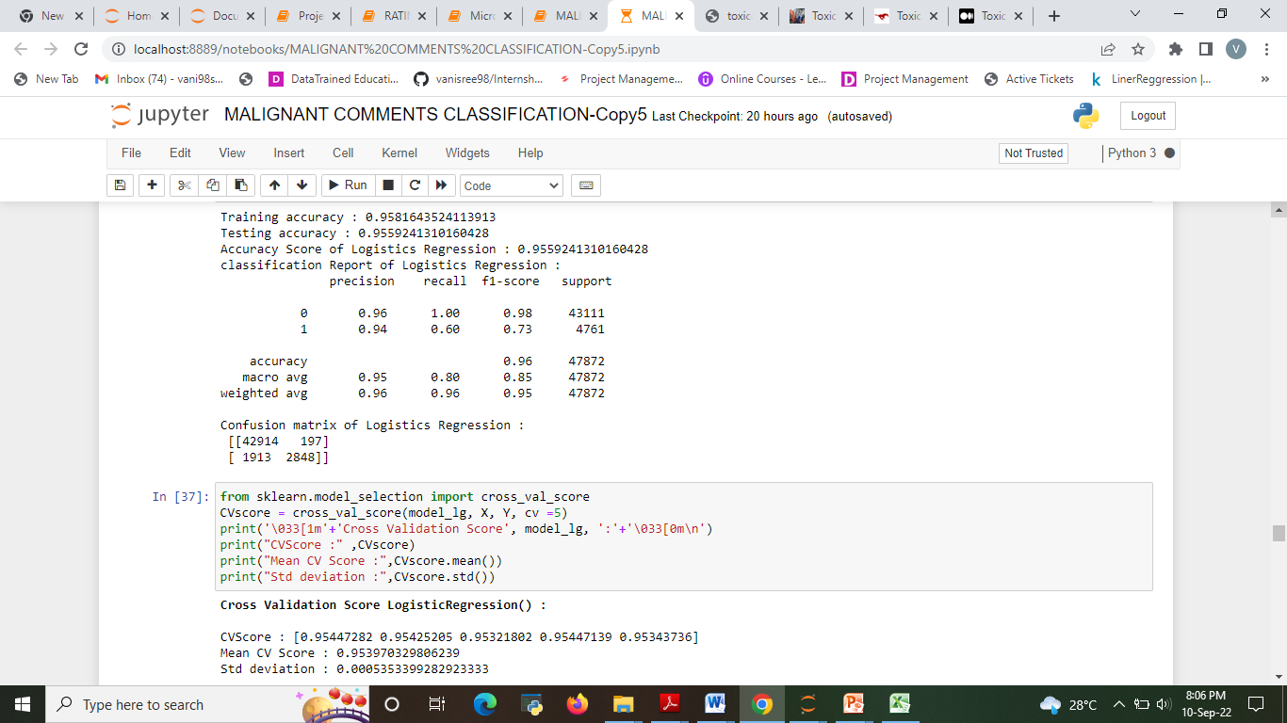

Slide 22
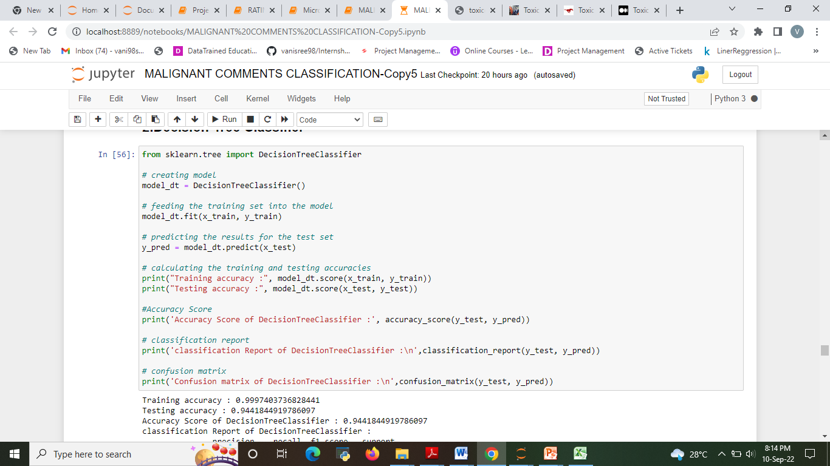
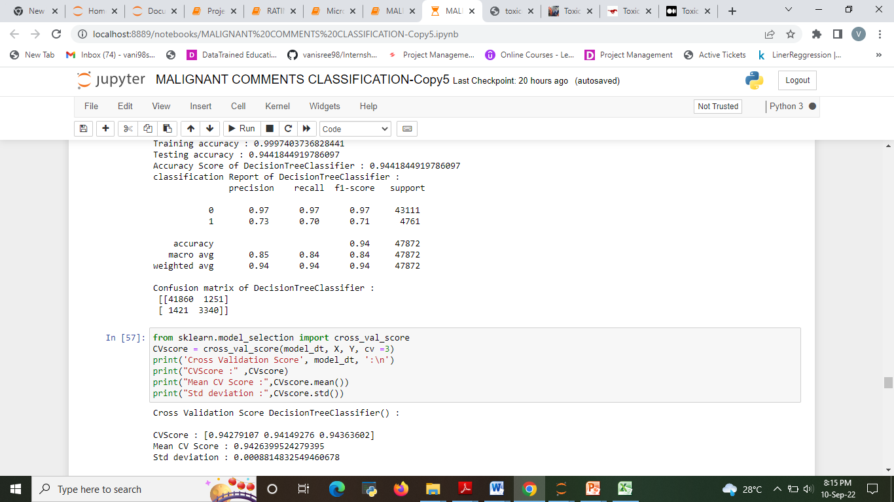
2. Decision Tree Regression

Slide 23
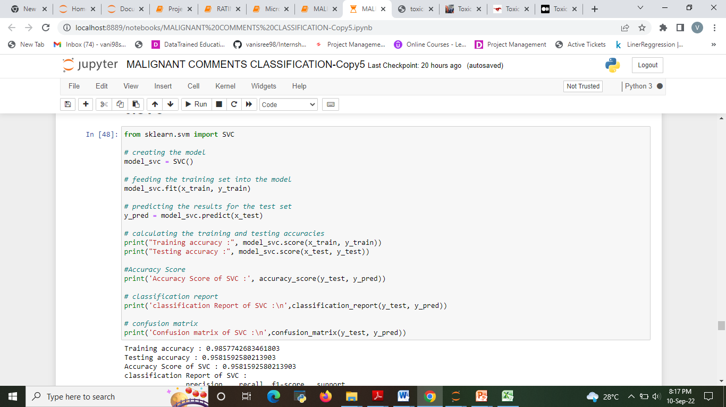
3.SVR

Slide 24
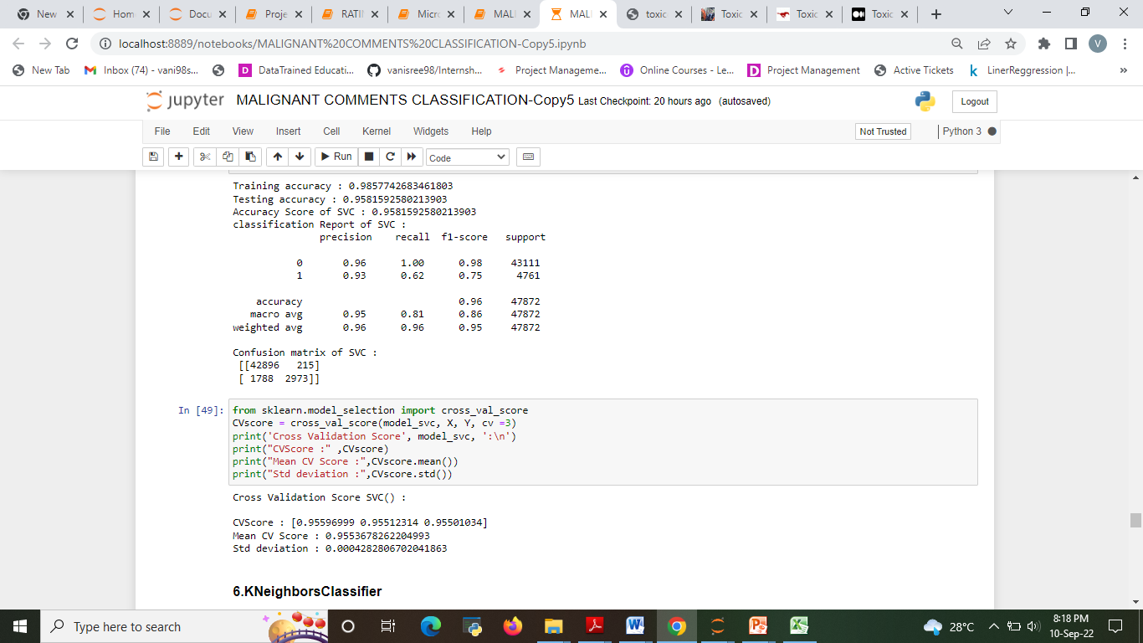

Slide 25
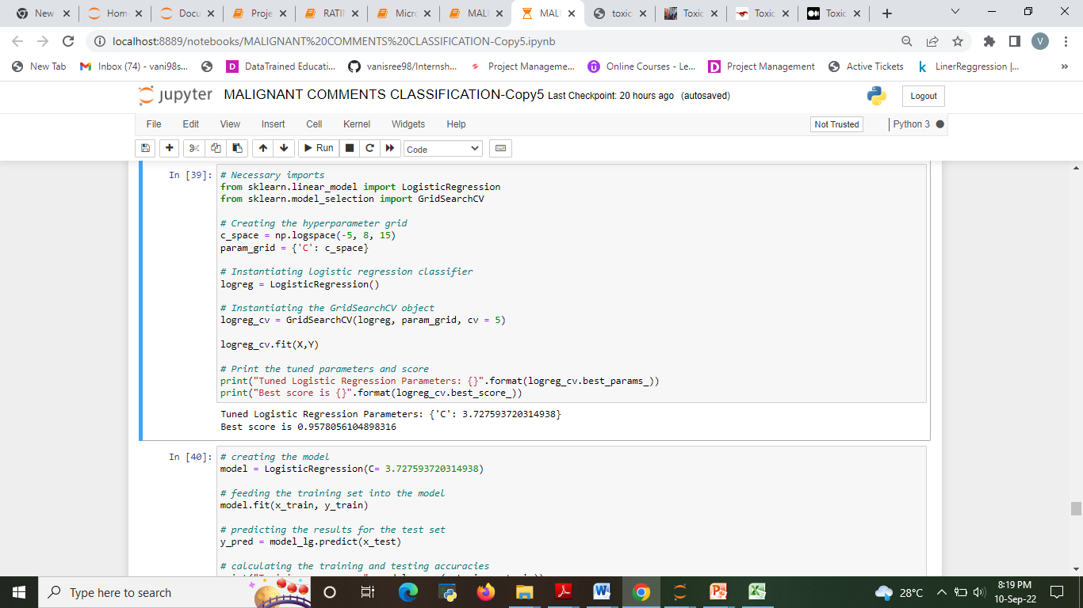
Hyper parameter tuning 1.Logistic Regression

Slide 26
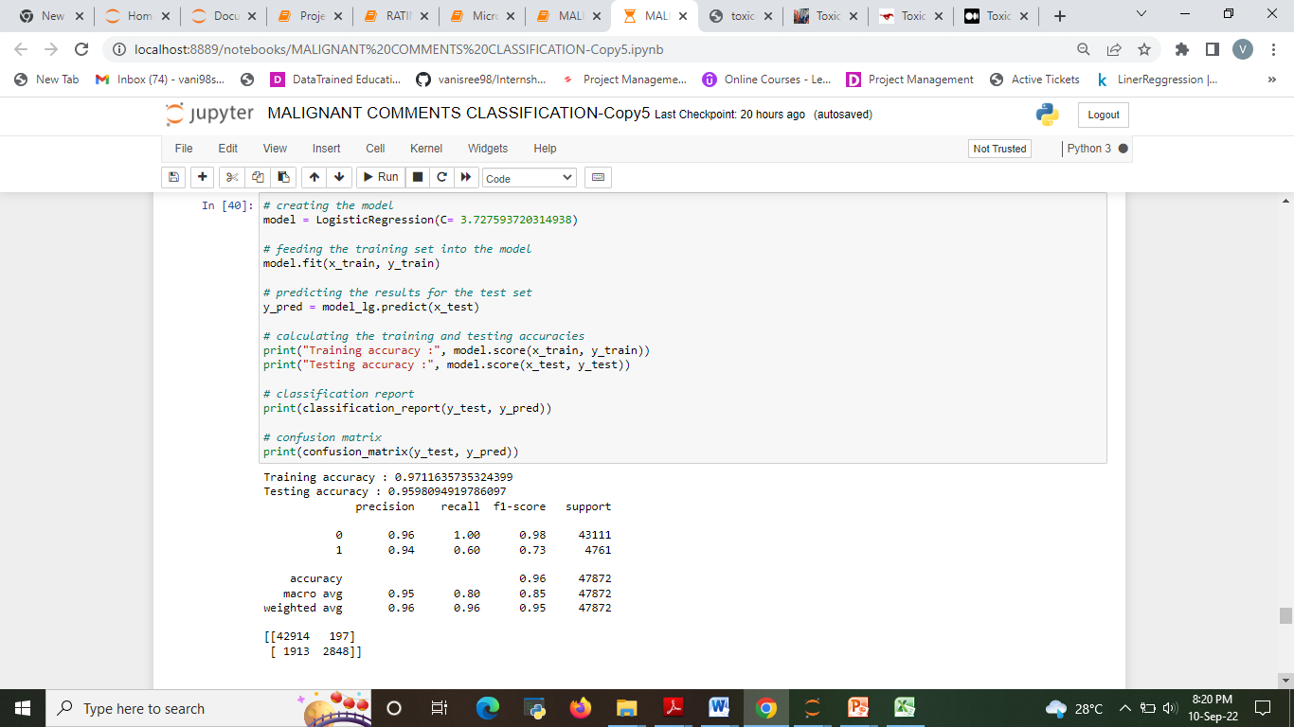
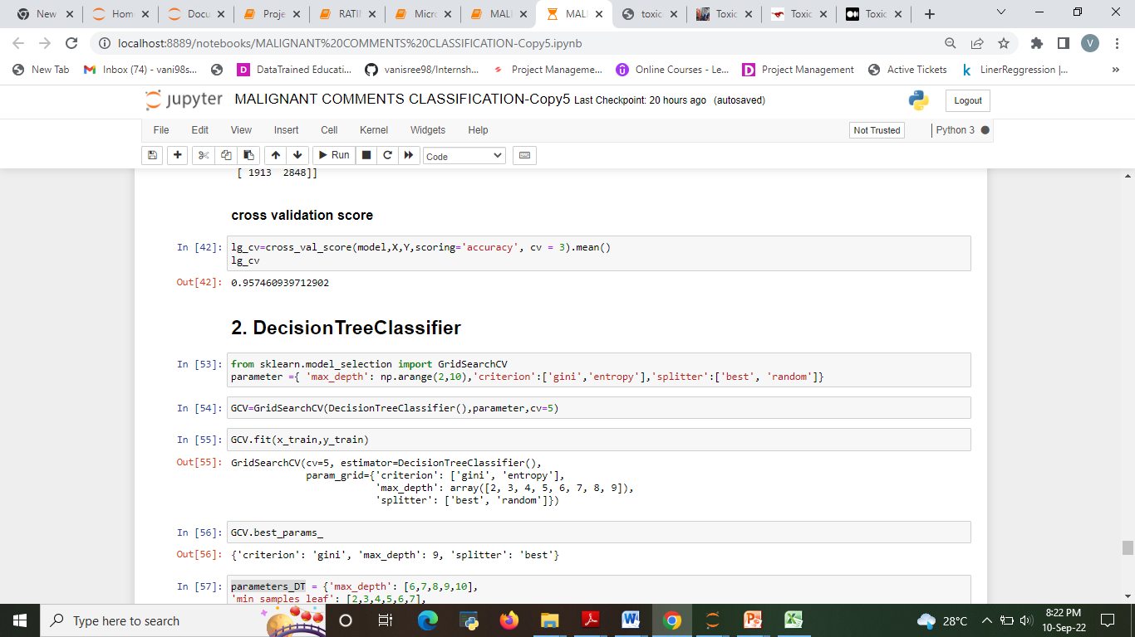

Slide 27
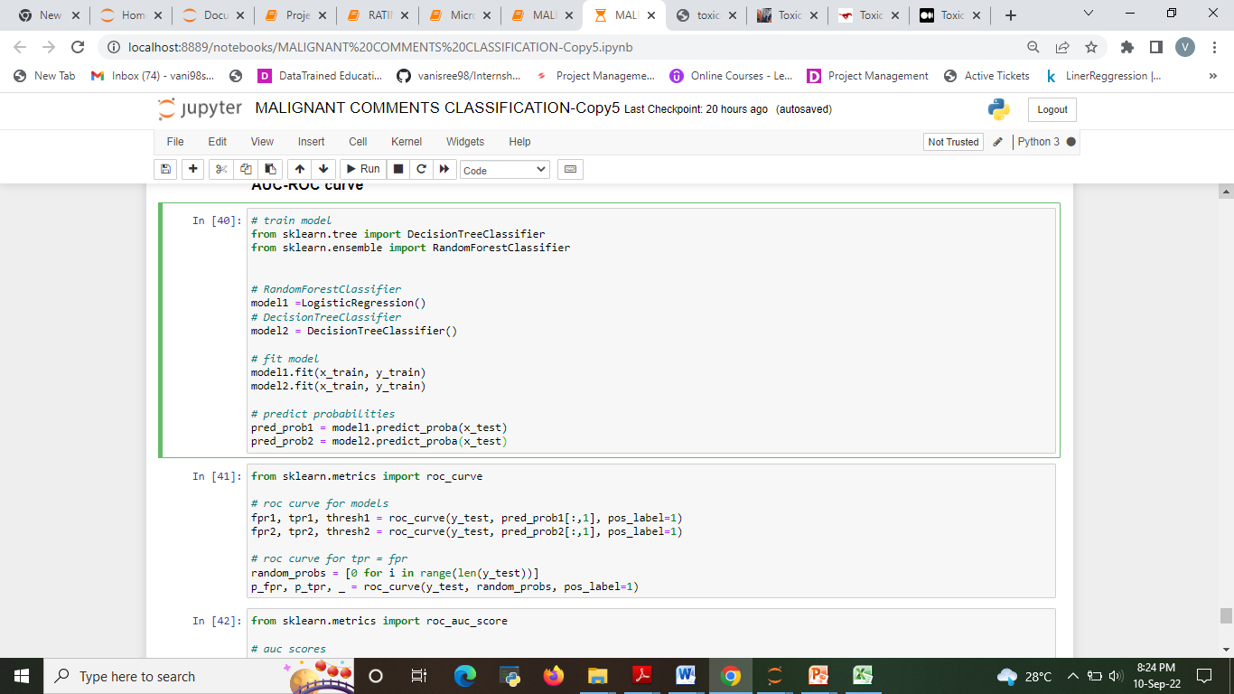
AUC-ROC curve

Slide 28
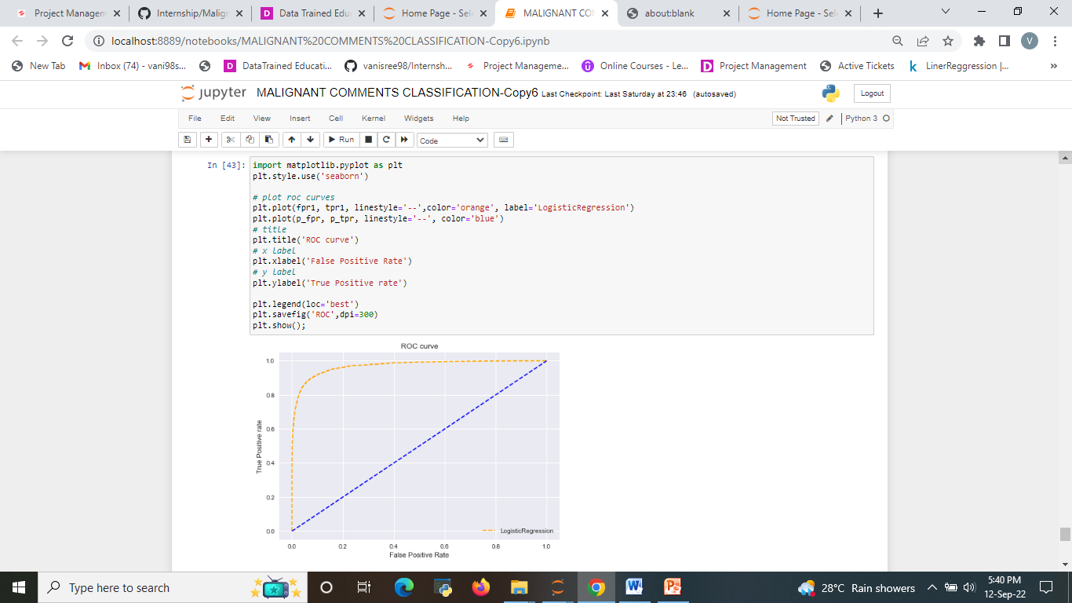
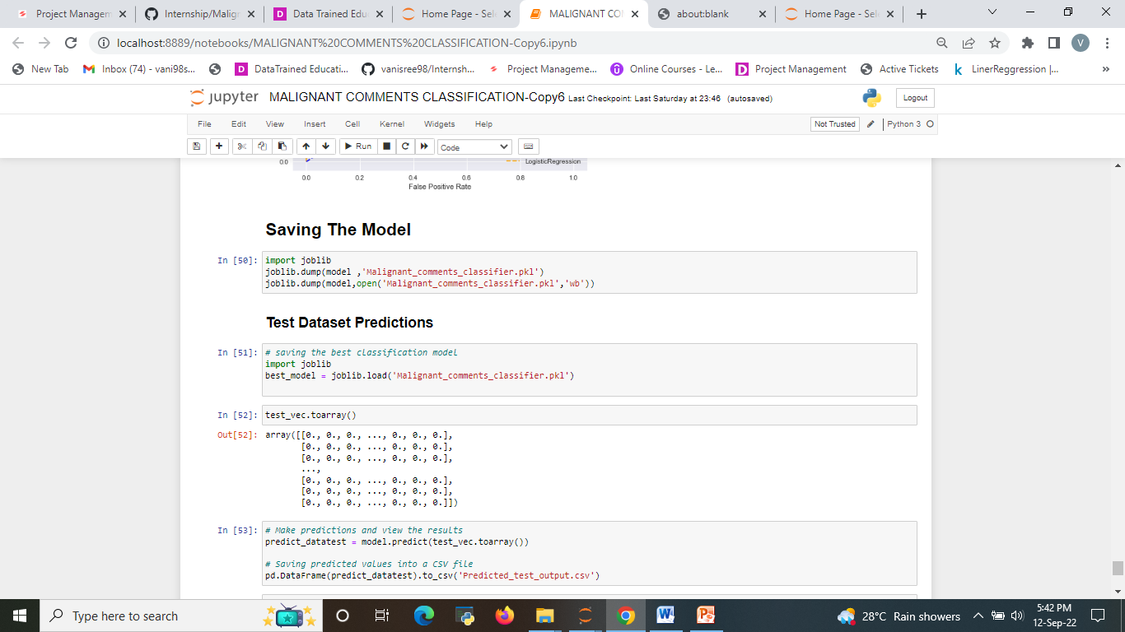

Slide 29
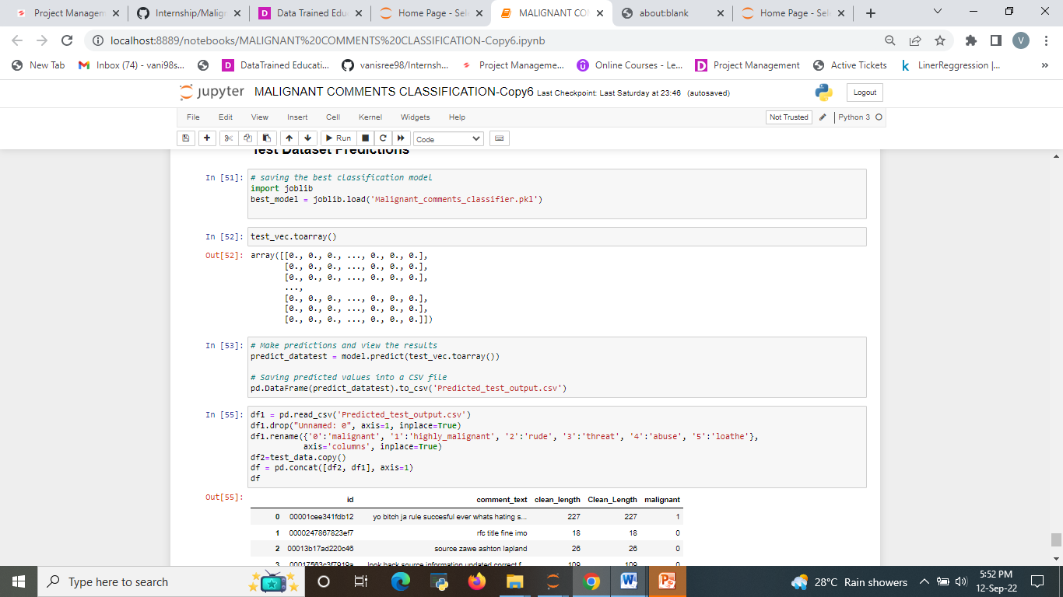
Test Dataset Predictions

Slide 30
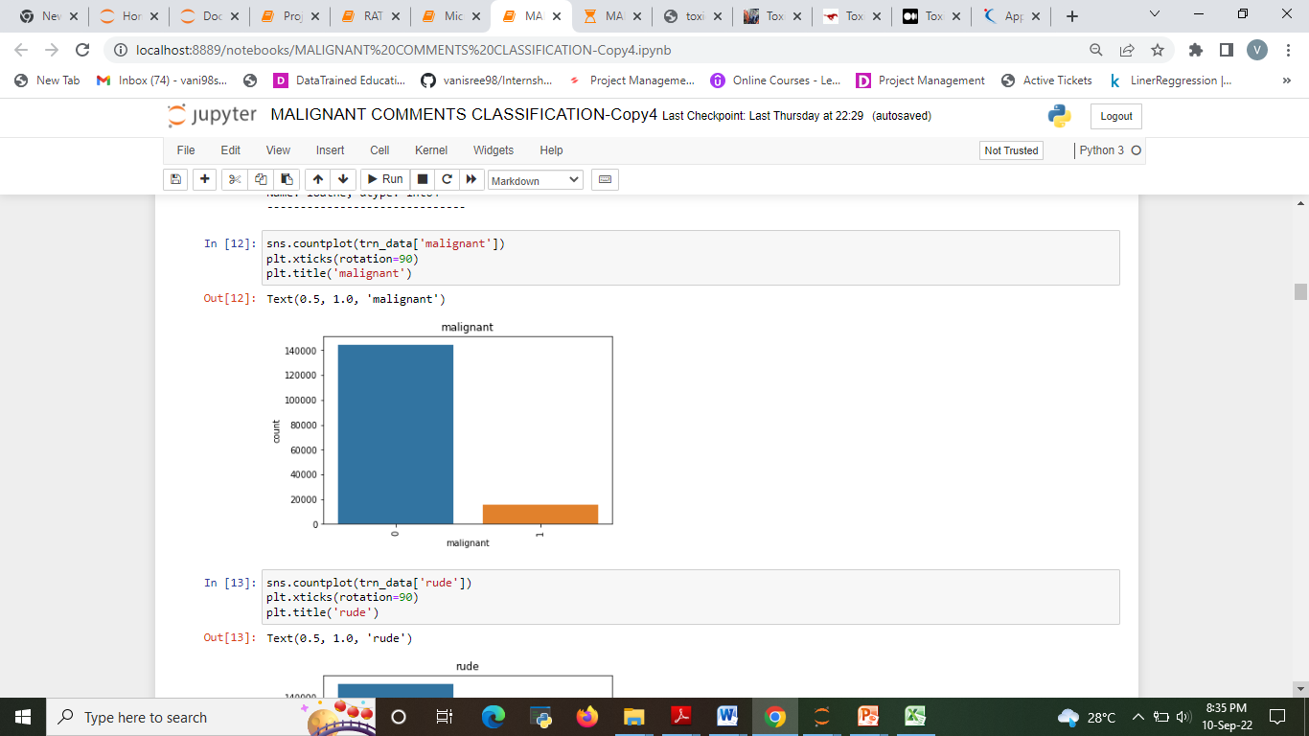
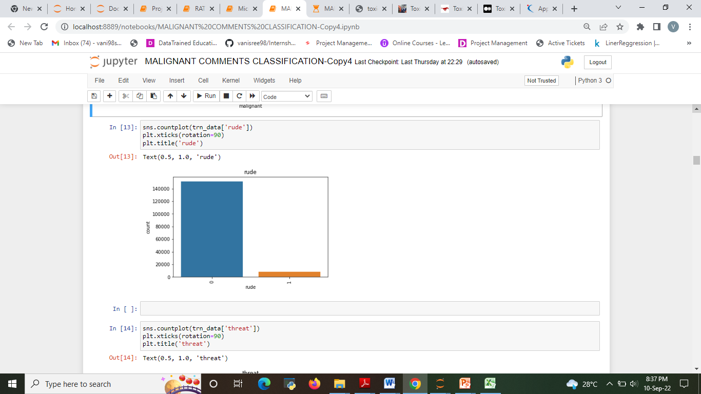
Visualizations
The Analysis of malignant of comments based on data

Slide 31
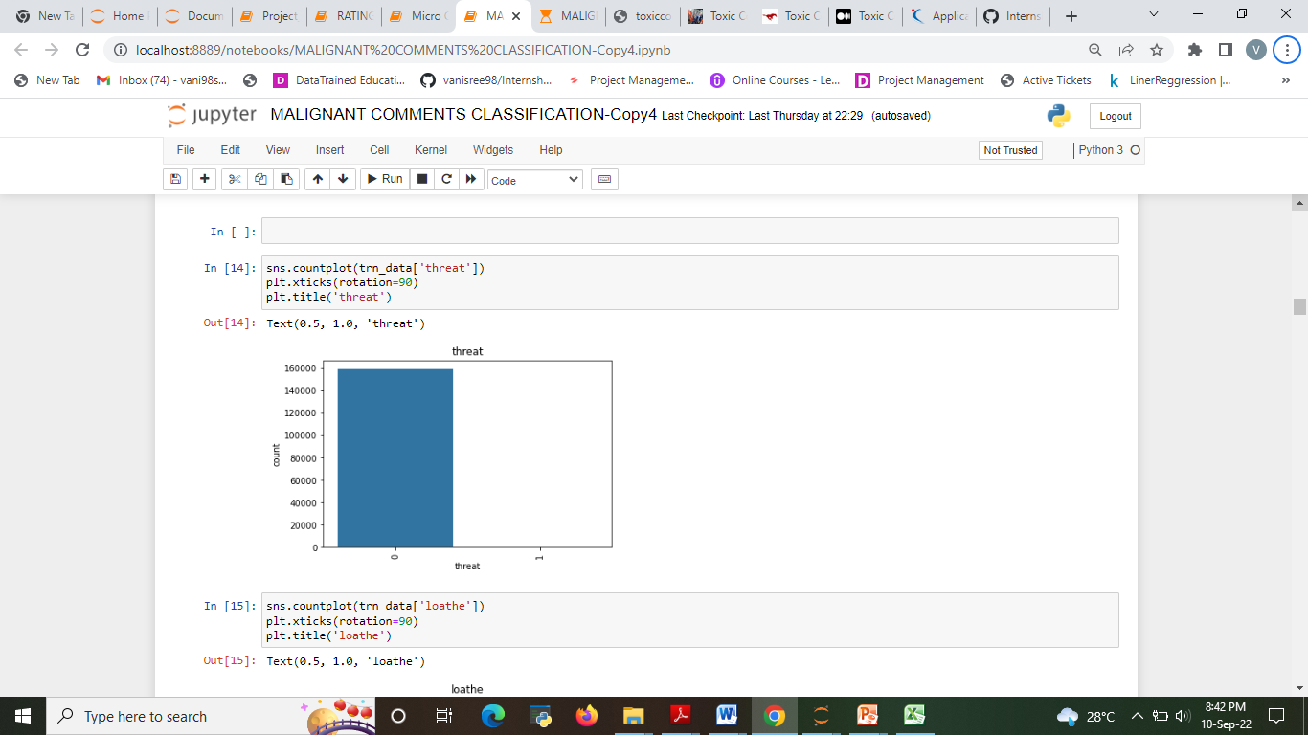
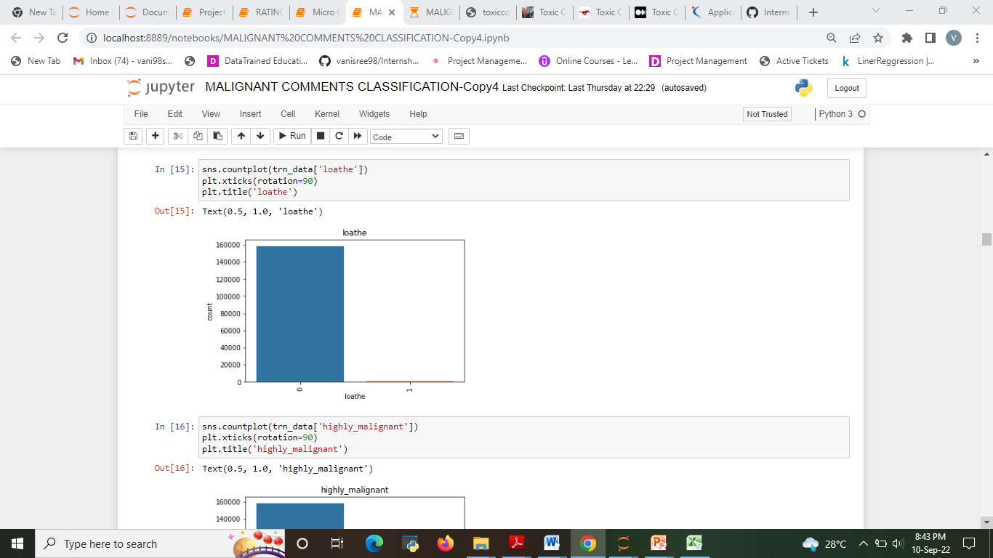
.

Slide 32
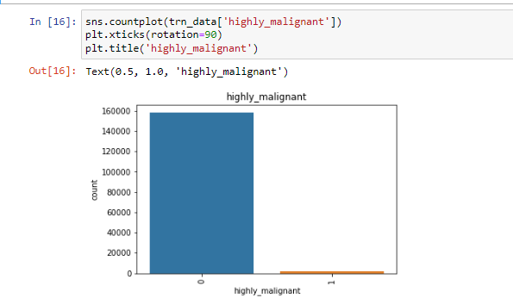
Out of total Negative comments the maximum negative comments come with Malignant in nature followed by rude categories.
Around 90% comments are Good/Neutral in nature while rest 10% comments are Negative in nature.
Very few comments come with threatening nature.

Slide 33
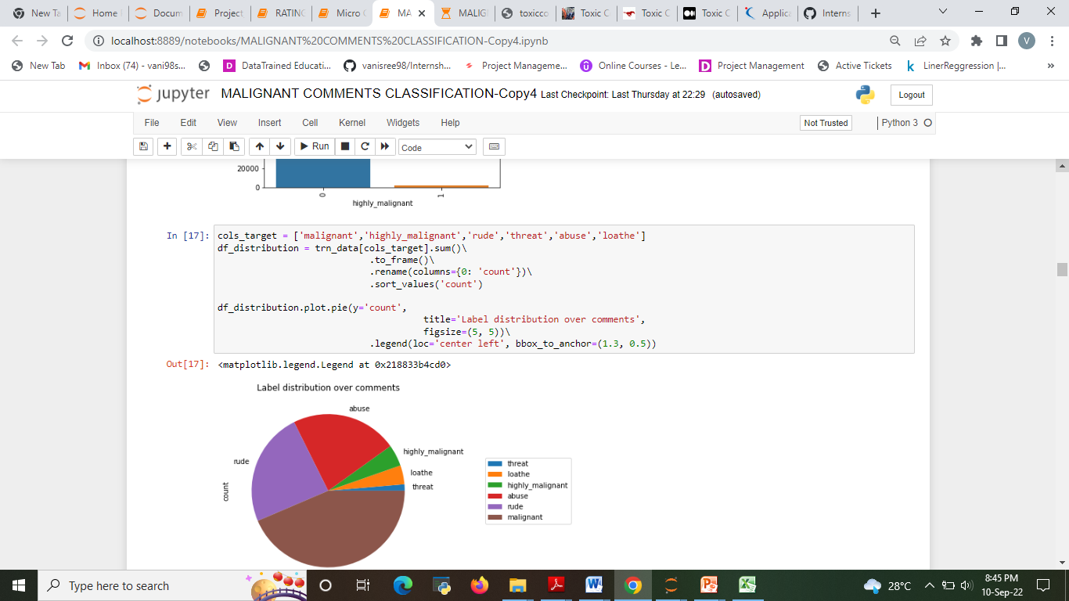
Out of total negative comments around 43.58% are malignant in nature followed by 24.07% are rude comments

Slide 34
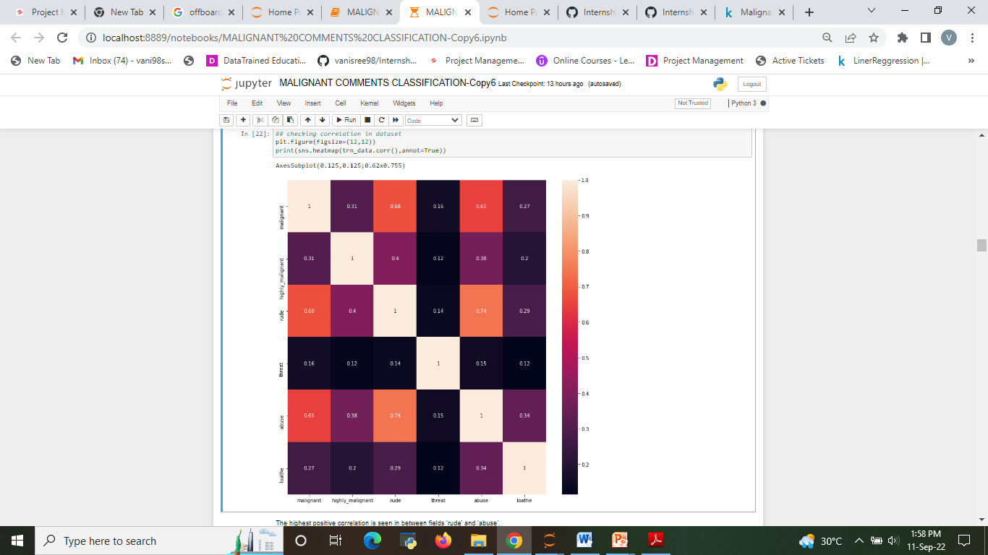
Correlation

Slide 35
Conclusion
From this dataset I get to know that each feature play a very import role to understand the data.
Data format plays a very important role in the visualization and Appling the models and algorithms ‘
Logistic Regression performs better with Accuracy Score: 95.59241310160 % than the other classification models. Final Model (Hyperparameter Tuning) is giving us Accuracy score of 95.6% which is slightly improved compare to earlier Accuracy score of 95.59%.
Logistic Regression is fastest algorithm compare to others.

Slide 36
Limitations and Scope
The current project predicts the type or toxicity in the comment. We are planning to add the following features in the future:
Analyse which age group is being toxic towards a particular group or brand.
Add feature to automatically sensitize words which are classified as toxic.
Automatically send alerts to the concerned authority if threats are classified as severe.
Build a feedback loop to further increase the efficiency of the model.
Handle mistakes and short forms of words to get better accuracy of the result.

